Slide 1
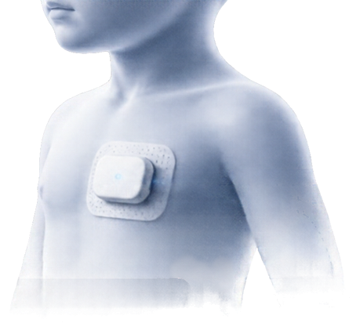




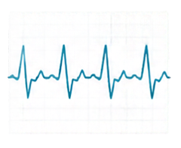





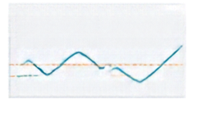


Pediatric VitalGuard AI
Adaptive Pediatric Measurement Reliability Analysis System
SENSOR CAPTURE
AI ANALYSIS ENGINE
RELIABILITY INSIGHTS
SIGNAL QUALITY
RELIABLE
Measure. Verify. Understand.
CONFIDENCE LEVEL
HIGH
detecting unreliable pediatric
vital-sign readings during movement
TREND OVER TIME
continuous vital-sign data capture
adaptive reliability assessment
MED-PS-010
MEDAITHON’26
Code4Cure
Team :
our mission: ensure every vital-sign reading
for children is accurate, reliable, and actionable.
HELLO WORLD !

Slide 2










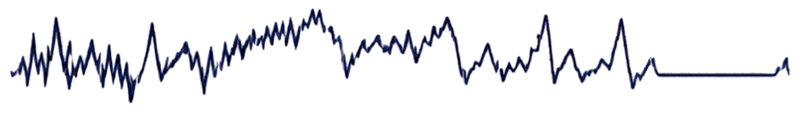


Why Are Pediatric Measurements Difficult?
Key challenges that impact the reliability of vital-sign readings in children
01
Movement and crying
CLEAN
SIGNAL
cause signal disturbances
Stable baseline • Clear peaks • Consistent rhythm
02
Poor sensor contact
degrades signal quality
NOISY
SIGNAL
Changing body size
03
complicates sensor positioning
High noise
Baseline drift
Irregular peaks
Missing data
04
Signal disturbances
Not all displayed vital-sign readings are reliable.
OUR OBJECTIVE
noise, baseline drift, missing data
Identify potentially unreliable readings and reasons for review.

Slide 3
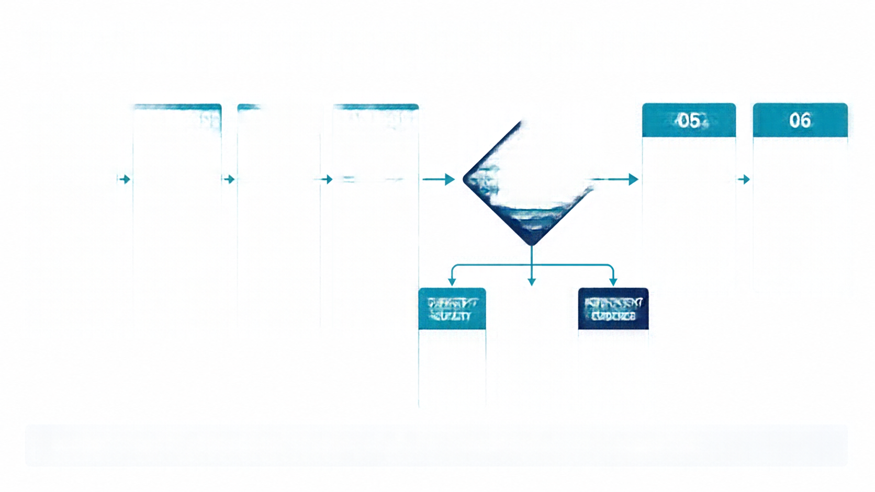


















From Measurement to a Reliable Next Step
01
02
03
04
05
06
Capture
measurement
Check
measurement
conditions
Analyze
signal
Assess
reliability
How reliable
is the
measurement?
Validate
physiological
value
Display all
results and
warnings
via physical
device with age-appropriate protocol
noise
baseline drift
amplitude
quality
indicators
calculate
explanable
quality score
motion
contact
missing samples
signal
interruptions
against age-specific
reference range
on dashboard
for clinician
review
identify causes
of degradation
motion & contact
sensors
SUFFICIENT
QUALITY
QUALITY
CONCERNS
INSUFFICIENT
EVIDENCE
display reading
with quality
status
flag interval
recommend
repeat or review
report
reliability
unknown
Software prototype simulates this workflow; physical sensor integration is future development

Slide 4


























Simulate. Analyze. Visualize.
Prototype architecture for controlled testing and validation
INPUT & SIMULATION
PYTHON FASTAPI ANALYSIS ENGINE
REACT + TYPESCRIPT DASHBOARD
MATLAB/Simulink synthetic signals
Data validation
Waveform display
Artifact detection
MATLAB scripts
Quality scores
Feature extraction
Warnings
Python fallback
Warnings
87
Baseline drift irregular peaks
Heuristic quality score
CSV uploads
Analysis report
Report downloads
KEY SIMULATED SCENARIOS
Prototype enables controlled testing
without physical device.
Clean signal
Movement disturbance
Baseline drift
Signal dropout
Mixed quality
Simulated signals drive repeatable validation and continuous improvement before real-world deployment.
stable baseline clear rhythm
irregular spikes high noise
slow baseline shift
missing signal segments
combination of artifacts

Slide 5







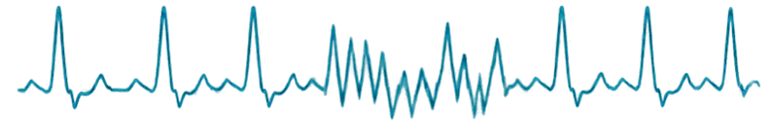












Explainable Analysis, Not Just a Score
Transparent quality score shows why a reading is reliable—or not.
SIGNAL REVIEW
QUALITY SCORE
SCORE COMPONENTS
Artifact detected
62
Data integrity
78
Signal quality
54
Signal
/100
Moderate concerns
Motion disturbance
41
Score shown only when enough evidence is available
Contact quality
72
Time
QUALITY OUTCOMES
PHYSIOLOGICAL VALIDATION
High quality
Moderate concerns
Low quality
Insufficect evidence
Configured pediatric reference range
Stable signal with minimal artifacts
Some issues detected that may affect accuracy
Multiple issues likely impact reliability
Not enough data to assess reliability
80 – 150
bpm
If not configured:
Contributing factors and flagged intervals are shown for review
Clinical reference range not configured
SAFETY NOTE:
Quality score is a heuristic indicator, not a clinical diagnosis or treatment recommendation.

Slide 6



























One Dashboard for Measurement Analysis
Unified view of signals, quality, artifacts, and data completeness
TECHNOLOGY STACK
Upload CSV
Download Report
MATLAB, Simulink,
MATLAB scripts
Sim Case Q7 – Motion + Cry
Simulation
PPG waveform
Signal-quality source
Python, FastAPI,
Pydantic, NumPy, Scipy
0.82
Signal integrity
0.85
Backend
Amplitude
Pulse consistency
0.81
Good
SNR
0.79
Frontend
React, TypeScript,
Vite, Recharts
Time (s)
Baseline stability
0.84
Pulse rate
SpO₂
Data completeness
Testing
Pytest, HTTPX,
Vitest, React Testing Library
118
97
bpm
%
Missing segments detected
12% of total duration
Time (min)
Time (min)
PRIVACY AND SAFETY
Artfact timeline
No patient data persistence
No third-party telemetry
No external APIs or uploads
00:00
01:00
02:00
03:00
04:00
05:00
Manual report downloads only
Motion artifacts
Signal dropout
Missing data
Prototype does not diagnose or treat
Dashboard is a conceptual mockup pending implementation verification.

Slide 7

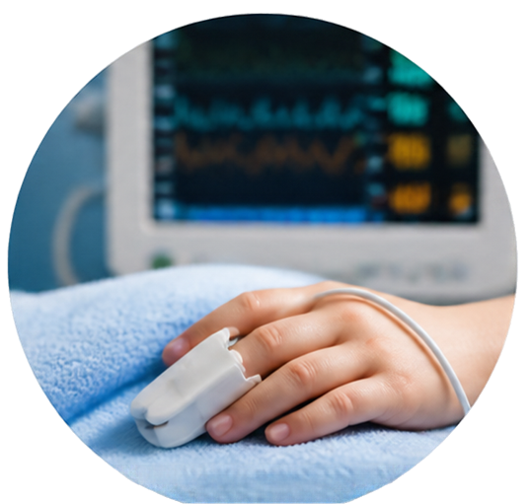








Toward More Reliable
Pediatric Measurements
Identify movement-related disturbances
Clarify measurement-quality limitations
Flag readings needing repeat or review
Provide Reproduable software testing environment
Support research in adaptive pediatric measurement
IMPACT
Size-adaptive sensor positioning
and validation mechanism for
pediatric age groups (investigative)
PATENT
DIRECTION
Measure. Verify.
Understand.
PHASE 1
PHASE 2
PHASE 3
PHASE 4
PHASE 5
Complete
software
simulation and
prototype
verification
Integrate
physical
motion and
contact
sensors
Develop and
verify age-appropriate protocols
Validate system with reference data and
configure
pediatric ranges
Biomedical
expert review
and clinical
validation
preparation
ROADMAP
MEDAITHON'26 | Code4Cure
Project MED-PS-010

